Slide 1
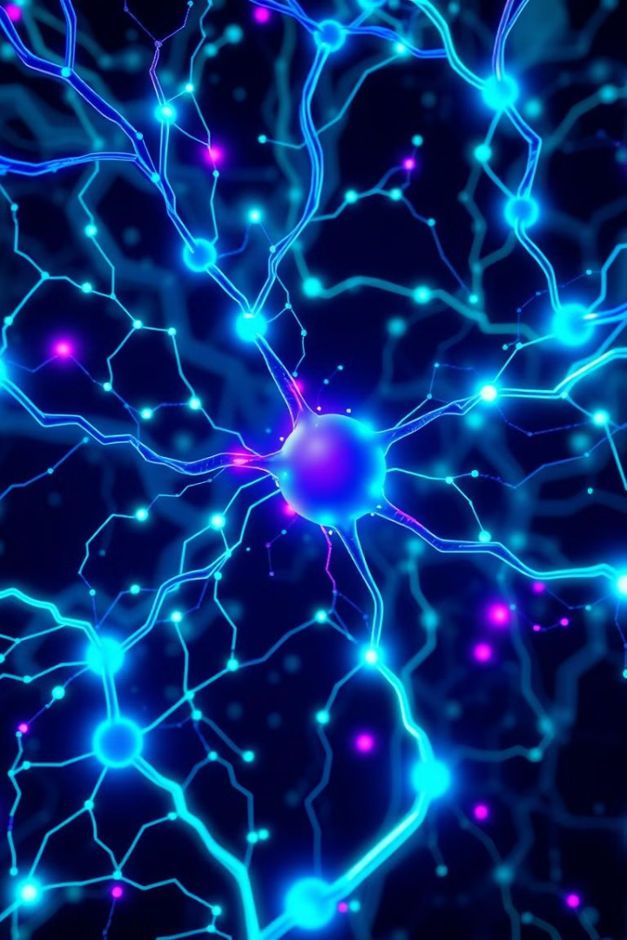

Artificial Intelligence in Marketing
This presentation will explore the transformative impact of artificial intelligence on modern marketing strategies.
by Jayesh Sharmila

Slide 2
AI Revolutionizes the Customer Experience
Personalized Experiences
Enhanced Customer Service
AI tailors content, offers, and interactions to individual preferences, creating a seamless and engaging experience.
Conversational AI chatbots provide instant support, answer questions, and resolve issues efficiently.

Slide 3
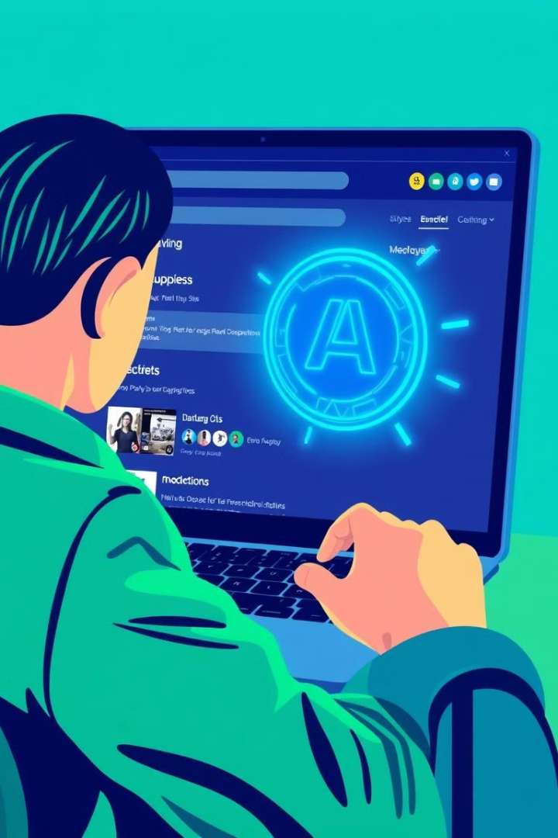
Personalization at Scale with AI-Powered Marketing
Targeted Content
Dynamic Pricing
AI analyzes user data to deliver relevant content, boosting engagement and conversion rates.
AI adjusts pricing based on factors like demand and customer behavior, optimizing revenue.
Product Recommendations
AI recommends products based on past purchases and browsing history, driving sales.

Slide 4



Predictive Analytics: Anticipating Customer Needs
Customer Churn
1
Predicts which customers are at risk of leaving and allows proactive intervention.
Demand Forecasting
2
Accurately predicts product demand, optimizing inventory and reducing waste.
Marketing ROI
3
Measures the effectiveness of marketing campaigns and identifies areas for improvement.

Slide 5
Intelligent Content Generation and Optimization
Content Creation
1
AI generates compelling and relevant content, including articles, social media posts, and email campaigns.
Content Optimization
2
AI analyzes content performance and suggests improvements for SEO, readability, and engagement.
Multi-Language Support
3
AI translates content into multiple languages, expanding reach and audience.

Slide 6
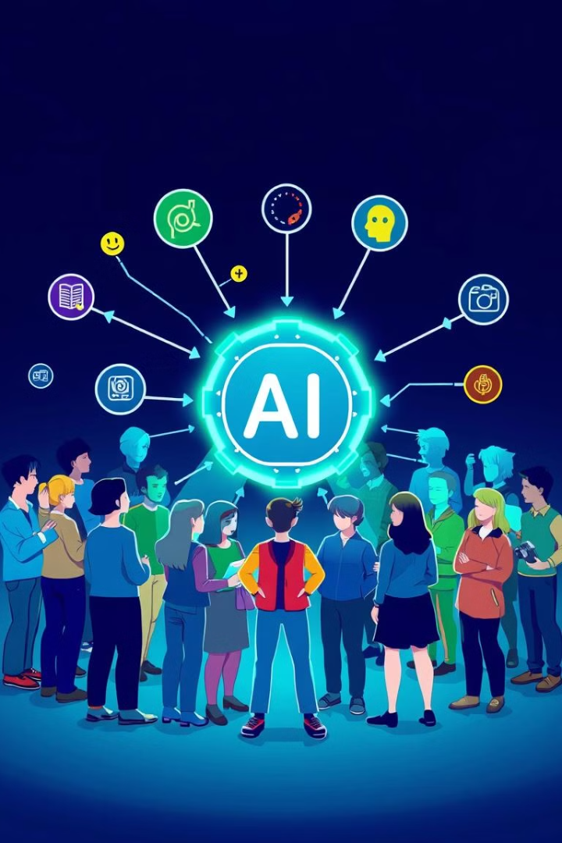



AI-Driven Audience Segmentation and Targeting
Demographic Segmentation
Behavioral Segmentation
AI groups customers based on age, location, income, and other demographic factors.
AI segments customers based on their online behavior, purchase history, and browsing patterns.
Psychographic Segmentation
AI categorizes customers based on their values, beliefs, lifestyles, and interests.

Slide 7

Automation and Efficiency in Marketing Workflows
Email Marketing
Ad Bidding
AI automates email campaigns, personalizes content, and optimizes timing for maximum impact.
AI optimizes ad bidding strategies across platforms, maximizing ROI and reducing wasted spend.
1
2
3
Social Media Marketing
AI schedules posts, monitors engagement, and analyzes performance for social media campaigns.

Slide 8
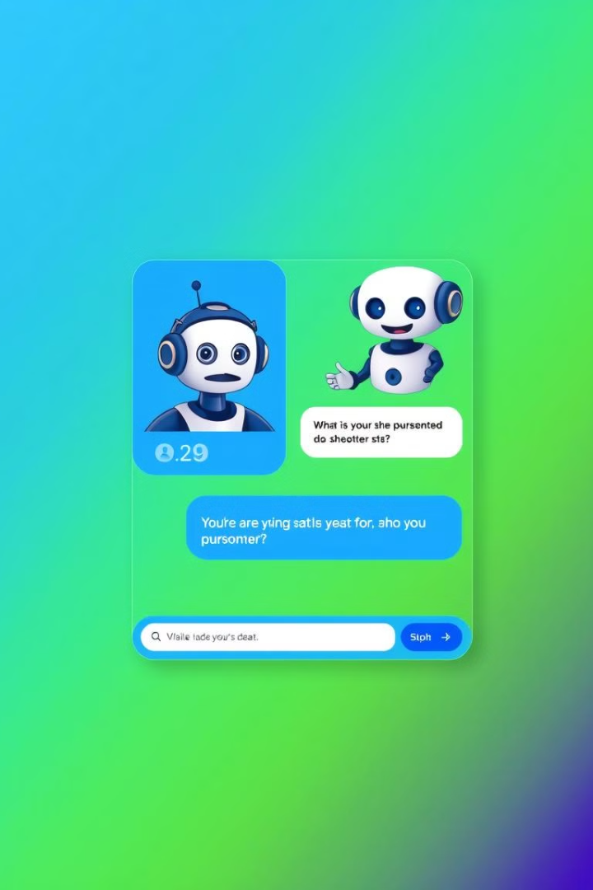



Conversational AI: Intelligent Customer Interaction
Customer Support
Chatbots offer instant assistance, resolving queries and providing information 24/7.
Lead Generation
AI chatbots qualify leads, gather information, and schedule appointments, streamlining the sales process.
Personalized Recommendations
Chatbots provide tailored product recommendations based on customer preferences and needs.

Slide 9
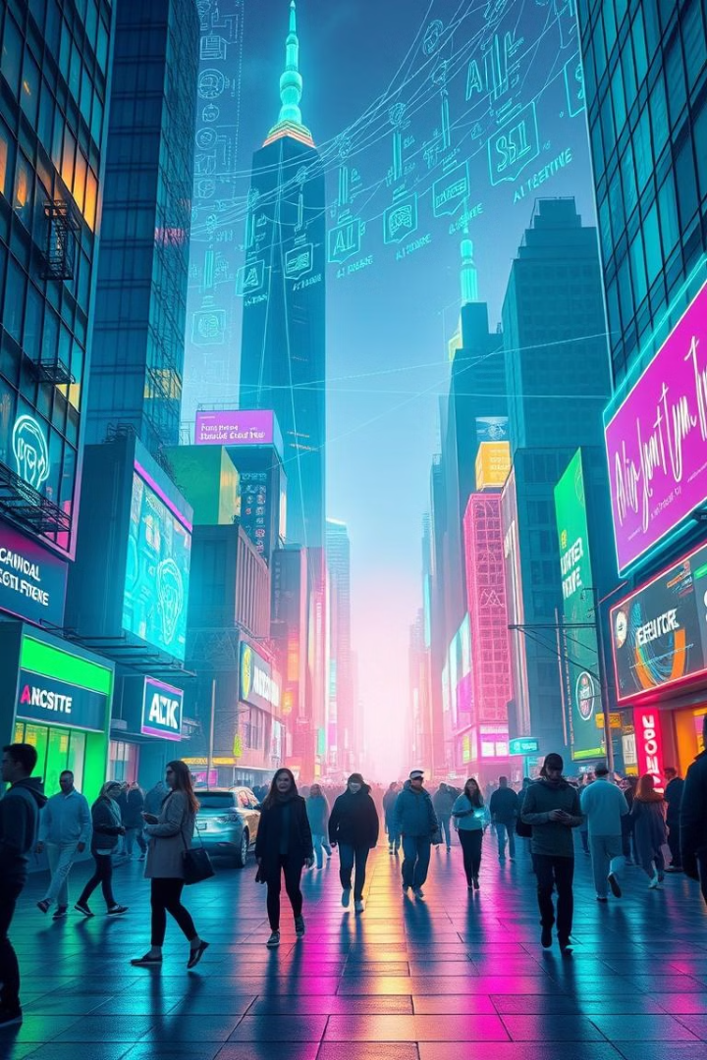
The Future of AI in Marketing: Emerging Trends
1
2
Hyper-Personalization
Predictive Marketing
AI will create even more personalized experiences, tailored to individual needs and preferences.
AI will anticipate customer needs and desires, proactively offering solutions and recommendations.
3
Ethical AI
AI will be developed and deployed responsibly, ensuring data privacy, transparency, and fairness.

Slide 10
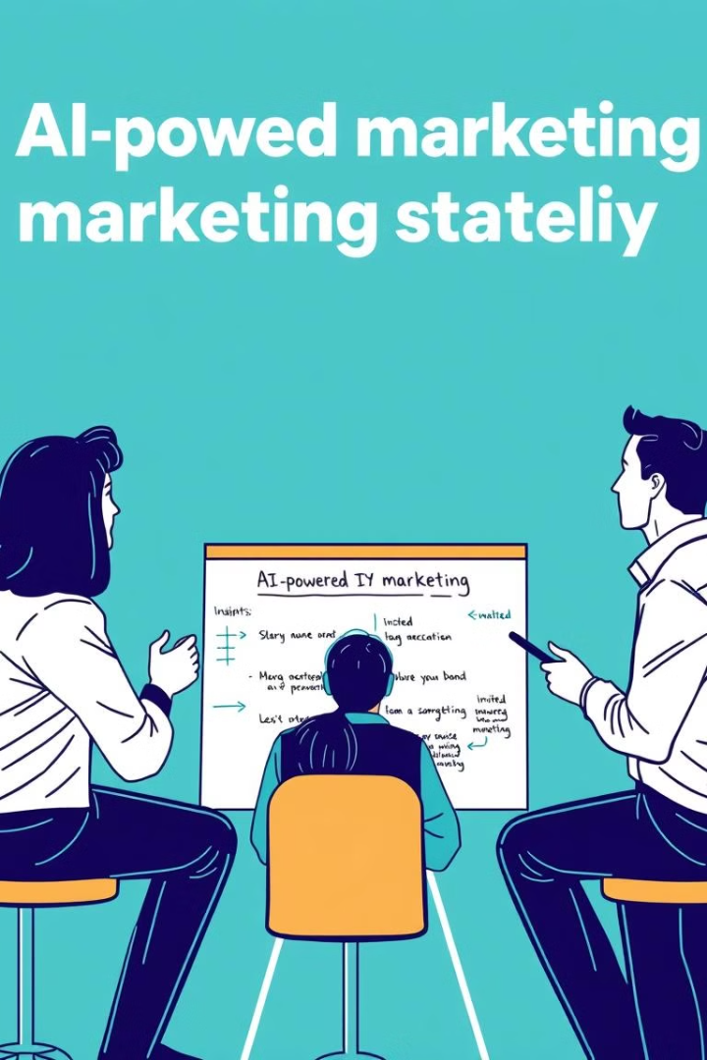
Key Takeaways and Next Steps
AI offers unprecedented opportunities to transform marketing strategies and enhance customer experiences. Embrace AI-powered tools and strategies to stay ahead in the competitive landscape. Explore potential AI applications within your specific industry and develop a roadmap for AI adoption.

